Slide 1
Public Relations
Budget Presentation March 24, 2021

Slide 2
Hello!
Public Relations Supervisor
Custodian of Records
Webmaster
Reach out to me at:
Office: (505) 368-4984 ext. 20131
Cell: (505) 263-9642
tabor@centralschools.org
I am
Roberto
Taboada

Slide 3
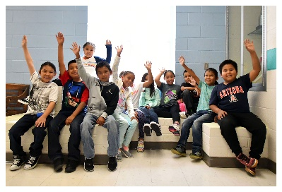
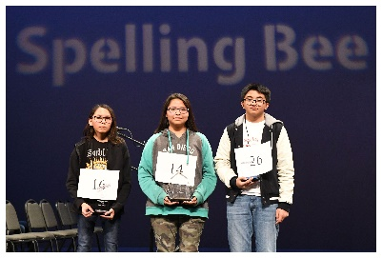
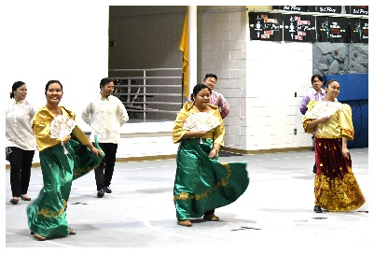
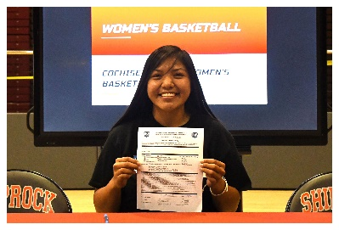
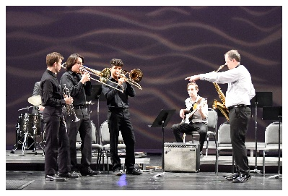
Public Relations Office: Goals
The Public Relations Office pursues effective communication to students, families, staff, community members, and the media. The goals are to provide accurate information and to be transparent. The office also monitors trends that have an impact on Central Schools, and to develop projects or campaigns around them, if needed.

Slide 4
Public Relations Office: Duties
Crafting messages
Responding to media inquiries
Pitching stories to media outlets
Photography & videography
Social Media, including promoting district and school events, news and awards
Website Updating & More:
Uploading files/forms and adding news
Training staff on the new platform
Conducting focus groups on ccsdnm.org
Livestreaming of events, including the Board of Education Meetings

Slide 5
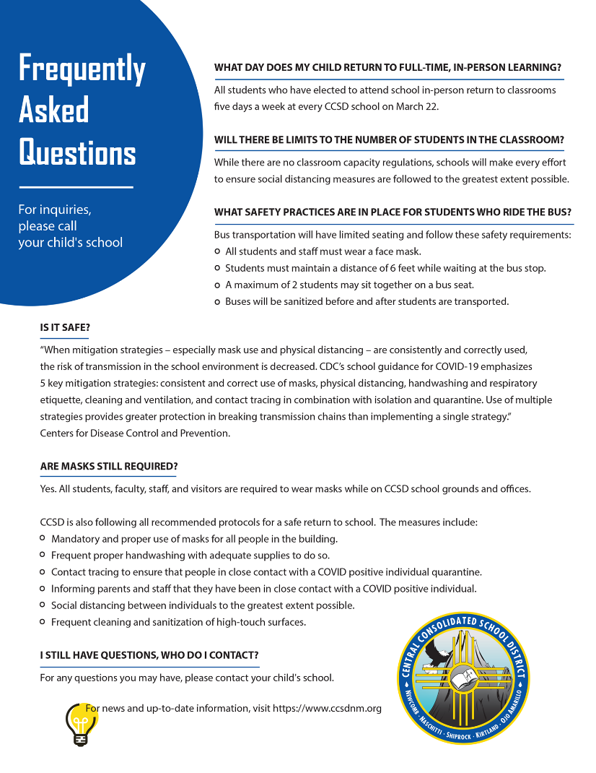
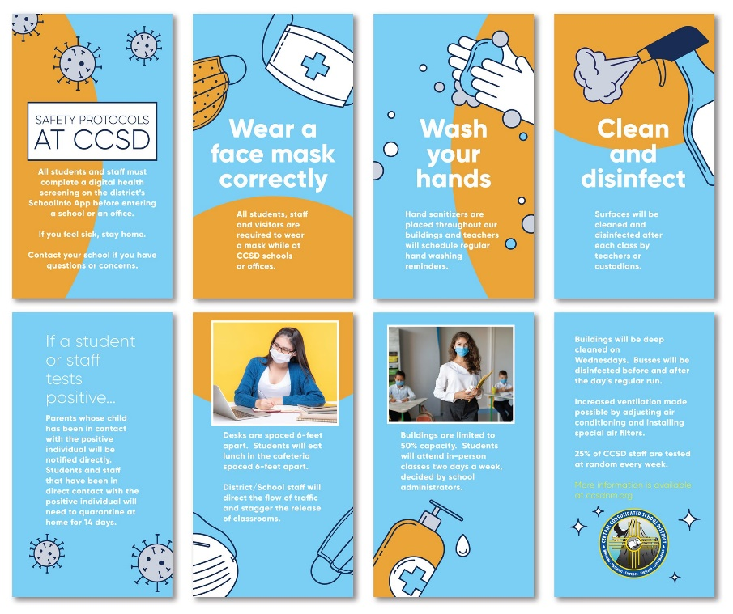
Duties (continued)
Contacting parents and staff: Robotexts/Robocalls/Surveys
Inclement Weather Messaging:
Sending information to families and staff
Adding information to KOB / KRQE / KOAT
Sending information to radio stations
Adding information to ccsdnm.org and social media
Robotexts/Robocalls
Public Records Requests
Creating ads for web, print and radio
Billboards
Collaborating on projects

Slide 6
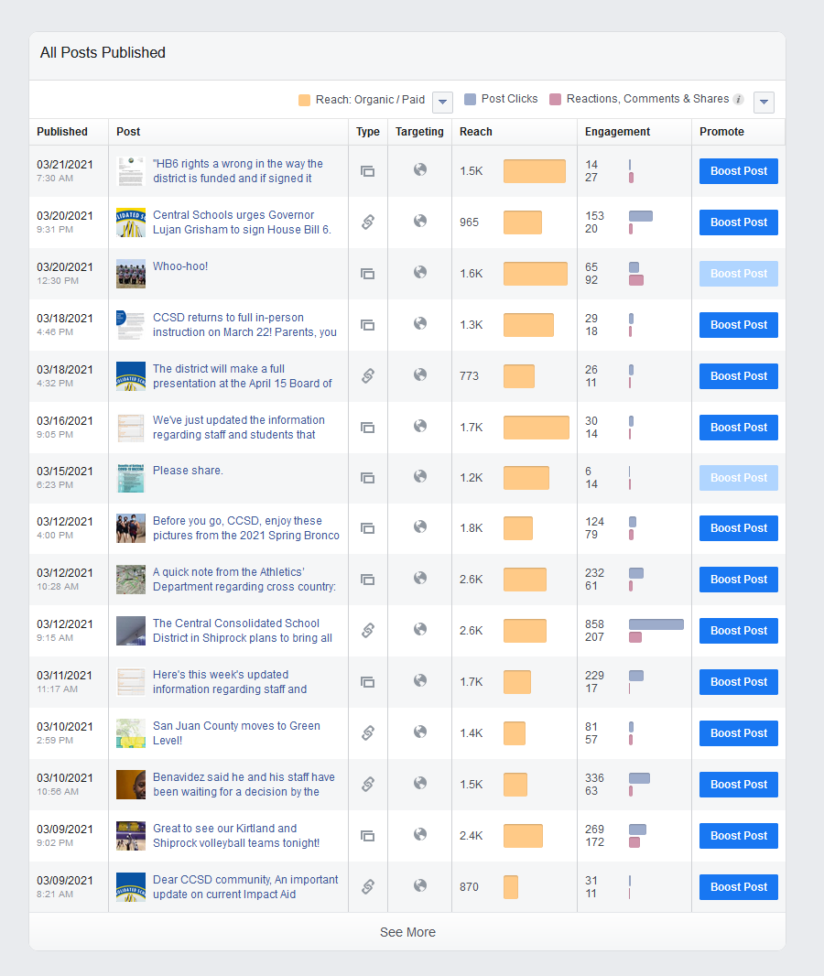
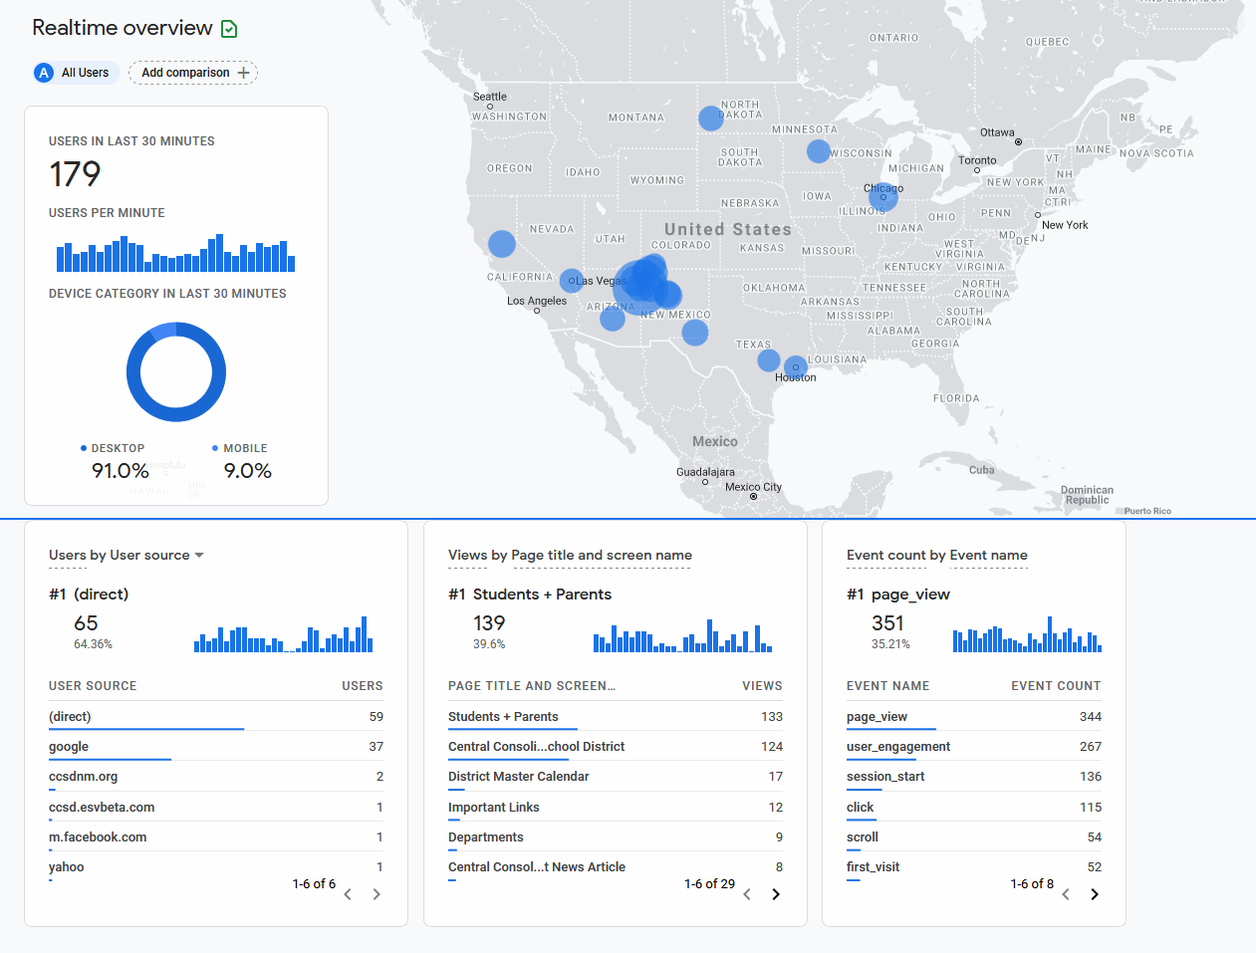
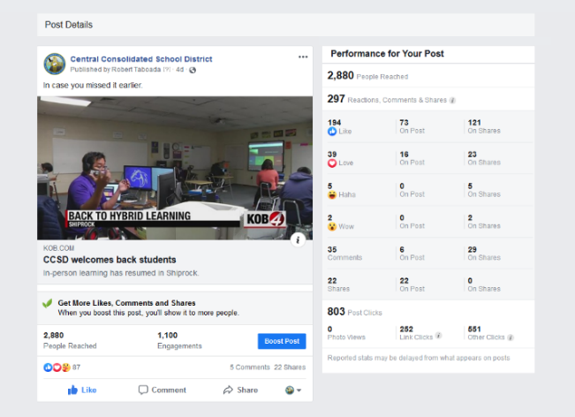
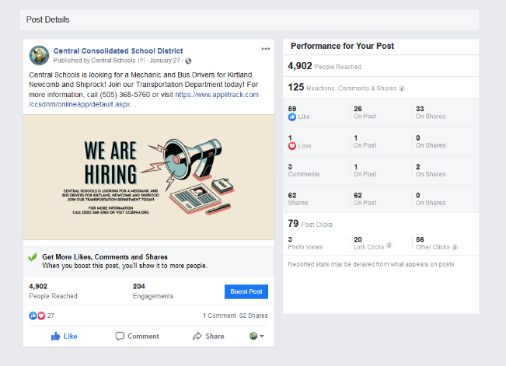
Public Relations Office: Data
Facebook Insights: We observe the reach of every post and promote messages based on importance and current traction.
Google Analytics: We follow information in real time on pages viewed to make sure the district’s messages and latest news are viewed.
We also observe survey data, Board of Education, and forums like the Public Input.
Facebook growth: 2,690 viewers in July 2018 to 5,790 in January 2021.

Slide 7
Public Relations Office: Budget
Advertising $10,000
Ads in newspapers, radio, billboards, and social media.
Covers the content management system.
Software $2,500
Covered applications for the old platform and surveys. Would cover the Adobe Creative Cloud.
Supply Assets $2,000
Covers technology and equipment needs (tripods, microphones, materials for livestreaming).
Employee Travel $595
General Supplies and Materials $500
Typically covers office supplies. This year, we purchased envelopes and stamps to send surveys to the Newcomb/Naschitti area.
Professional Development $1,000
Other Contracts Services $2,000

Slide 8
Thank you!
Any questions?
Remember to visit
Website: ccsdnm.org
Instagram: @ccsdnm
Facebook: @CentralConsolidatedSchools

